Slide 1


Three-dimensional simulation of neurotransmitter flow in a presynaptic bouton
Biologically inspired algorithms
Lecture - 10.IV.2024

Slide 2
Lecture outline
Formulation of the problem
Finite element method
Two- and three-dimensional meshes
Modeling a presynaptic bouton
Mathematical model
Two-dimensional simulations
Simplified three-dimensional model
Simulations in 3D with the simplified model
Realistic three-dimensional model

Slide 3
Formulating the problem
Subject of the work: synaptic depression
The goal of the research
Previous studies
2023-11-13

Slide 4
Research subject Nervous system → neuron → synapse → presynaptic bouton
Adult human brain contains about 10¹¹ neurons and 10¹⁴ synapses
In nervous system impulses are transmitted through synapses:
chemical – cleft size 20-40 nm
electrical – cleft size 3,5 nm
Chemical synapse consists of:
Axon ending i.e. presynaptic bouton of the first neuron;
Synaptic cleft;
Postsynaptic bouton of the second neuron.

Slide 5
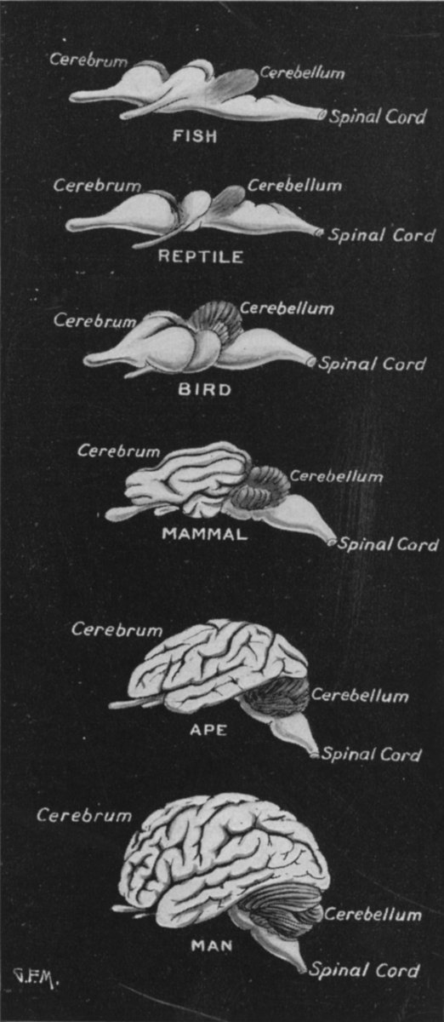
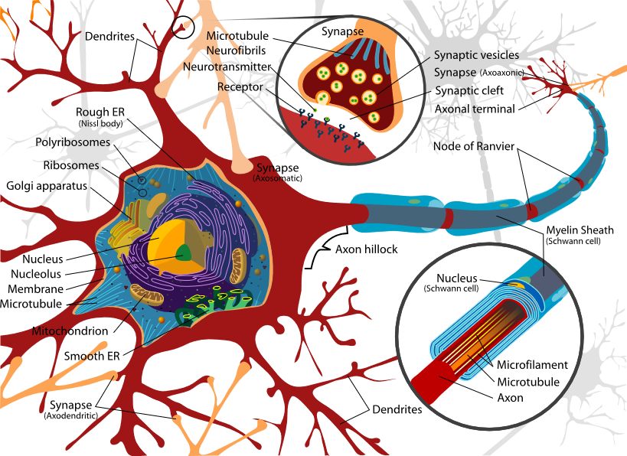

Research subject – presynaptic bouton
Brain→ Neuron → Synapse → presynaptic bouton with vesicles
https://pl.wikipedia.org/wiki/Mózg
https://en.wikipedia.org/wiki/Neuron#/media/File:Complete_neuron_cell_diagram_en.svg

Slide 6
Synaptic depression and the goal of the work
Neurotransmitter (NT) shortage in a neuron
impairing the sensitivity to incoming nerve impulses - synaptic depression
THE AIM OF THE WORK is building a model of neurotransmitter flow in a presynaptic bouton which would broaden our knowledge of this phenomenon and would allow us to simulate the way nervous impulses are conducted as well as the way various factors (for example the shape of the bouton) influence this process.
The model can be verified eg. by detecting synaptic depression with the pattern similar to that described in literature.

Slide 7
Biological parameters
Synapse diameter – about a micrometer;
Synaptic cleft width – about 20-40 nm;
Single impulse (stimulation) – order of microseconds;
Example papers:
I) About the presynaptic bouton
Schneggenburger R., T. Sakaba, E. Neher, 2002. Vesicle pools and short-term synaptic depression: lessons from a large synapse. Trends in Neurosciences 25(4):206–212
II) About simulation and differential equations
F. Aristizabal F., M. I. Glavinovic, 2004. Simulation and parameter estimation of dynamics of synaptic depression. Biol. Cybern. 90:3–18

Slide 8
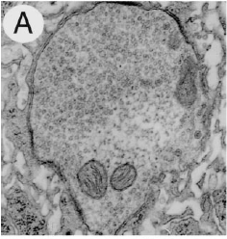
Real presynaptic bouton with vesicles
Zhang et al. 1998, Neuron

Slide 9
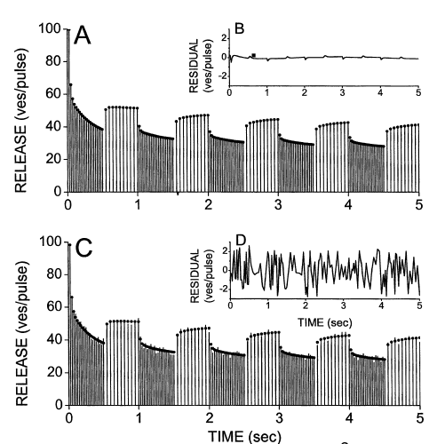
Research with electrical circuits (ODE - Biol. Cybern. 90:3–18)
The plot of the number of released vesicles in time
without noise (A,B), with noise (C,D)

Slide 10
Theoretical assumptions of the model of presynaptic bouton
Bielecki A., P. Kalita, 2008. Model of neurotransmitter fast transport in axon terminal of presynaptic neuron. J. Math. Biol. 56:559–576
Kolbka presynaptyczna - obiekt (bryła) o stałym położeniu w przestrzeni 3D Obszar uwalniania cząsteczek NT na zewnątrz - ustalony podzbiór jej brzegu;
Gęstość neuroprzekaźnika w obszarze kolbki - niewiadoma;
Pęcherzyki dyfundują w całej przestrzeni kolbki, zaś ich synteza ma miejsce w pewnym podzbiorze tej przestrzeni (tzw. obszar syntezy);
Wydajność syntezy NT - stała lub proporcjonalna do różnicy między jego chwilową gęstością a gęstością progową;
Nadejście potencjału czynnościowego (tzw. iglicowego) umożliwia uwalnianie cząsteczek NT na zewnątrz komórki przez określony interwał czasu, w ilości proporcjonalnej do koncentracji pęcherzyków w bezpośrednim otoczeniu obszaru uwalniania;
W modelu nie uwzględniono wychwytu zwrotnego NT.

Slide 11
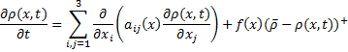
Assumptions (2): Mathematical model
Nonlinear partial differential equation
Explanations (ves = synaptic vesicle):
x = [x₁, x₂, x₃] albo [x,y,z] – point in Ω (in the bouton)
t – time coordinate of the simulated phenomenon [s]
ρ(x,t) : neurotransmitter (NT) density (ves/μm³);
ρ(x,0) = ρ₀ ;
a_{ij} : diffusion tensor (diagonal) (μm²/s)
f(x)=β(x) : synthesis rate distribution
Uniform distribution assumed: β(x) = β₀ [1/s]
ρ : synthesis threshold of NT [ves/μm³]
2023-11-13

Slide 12
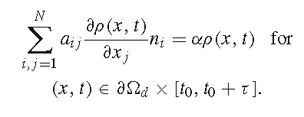
Assumptions (3): boundary condition
Boundary condition in finite element method (FEM)
, 0 – otherwise
Explanations:
∂Ω_{d} - Secretion zone of NT (active zone);
α – exocytosis rate [μm³/s];

Slide 13
Finite element method – design of the object
„The finite element method (FEM) is a numerical method for solving problems of engineering and mathematical physics. Typical problem areas of interest include structural analysis, heat transfer, fluid flow, mass transport, and electromagnetic potential. The analytical solution of these problems generally require the solution to boundary value problems for partial differential equations. The finite element method formulation of the problem results in a system of algebraic equations. The method yields approximate values of the unknowns at discrete number of points over the domain.
It subdivides a large object into smaller, simpler parts – finite elements. The simple equations that model these finite elements are then assembled into a larger system of equations that models the entire problem. FEM then uses variational methods from the calculus of variations to approximate a solution by minimizing an associated error function.”
From Wikipedia, the free encyclopedia
Two- and three-dimensional meshes
Two-dimensional mesh – triangles
Three-dimensional meshes - tetrahedra

Slide 14
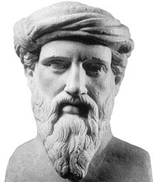
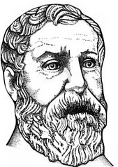
Finite element method (2D)
Surface mesh may consist of polygons
Triangles
Rectangles
Other …
Advantages of using rectangles (esp. squares)
Fit easily some objects (buildings, machines etc. …)
Regular pattern of coordinates
It is not necessary to store them in memory
Advantages of using triangles
Many simple formulas exist ( for a long time ☺ )
The shortest distance between the centers of two adjacent mesh elements

Slide 15
Angles (a short reminder):
acute | right | obtuse | straight | reflex | perigon
Angle: From Wikipedia, the free encyclopedia

Slide 16
Finite element method (2D)
Quality measures of 2D (triangular) mesh
For each triangle, calculate:
1) „longest edge”/„shortest height” rat(io (EH, E_TO_H);
2) „longest edge”/„inscribed circle radius” ratio (ER, E_TO_R);
3) „perimeter”/„square root of the area” ratio (PS2, P_TO_S2)
Assume that in each case: 1), 2) or 3), the mesh quality measure is the worst element quality measure
To assess the quality of the mesh, compare:
the worst quality measure with the „ideal case”
(quality measure of the equilateral triangle);
the result of the simulation with the „ideal case” (the solution of which may be calculated with any desired precision)
the area or perimeter of the mesh with that of the real object (if available)

Slide 17
Finite element method (2D)
Quality of triangular mesh (continued)
Ideal values for the equilateral triangle:
the longest edge length / the shortest height length
formula: EH = a / h = a / (a∙(3^{0,5})/2) ≈ 1,1547
the longest edge length / the radius of the inscribed sphere
formula: ER = a / r(ins) = a / ( a ∙ (3^{0,5})/6 ) ≈ 3,4641
the triangle perimeter / the square root of the surface
formula: PS = 3a / ( (3^{0,5}/4)a²) ^{0,5}) ≈ 4,5590

Slide 18
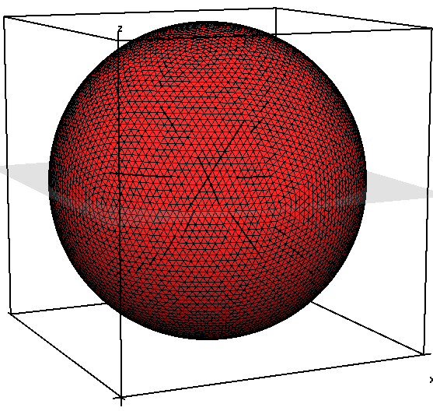
Finite element method (2D)
Example mesh – one of the initial shapes used to model the presynaptic bouton
„Geosphere”: a sphere covered with (almost) identical (almost) equilateral triangles;
15680 faces (triangles)
7842 vertices (points)
R = 1.6 (±0.00002) [μm]

Slide 19
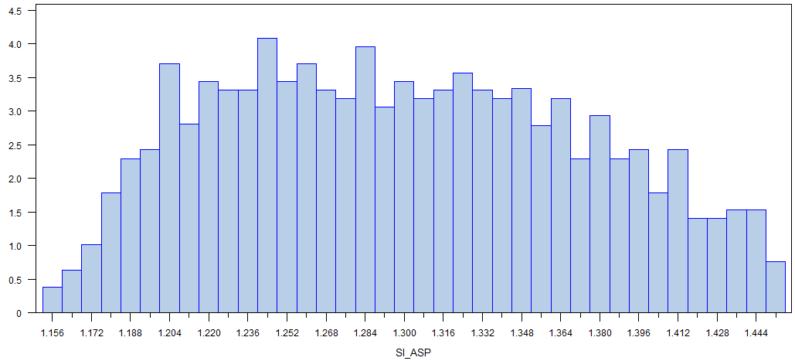
Finite element method (2D)
Parameters of geosphere triangular mesh:
Max(EH) ≈ 1.4527 (125.81% x EH_min.)
EH_ideal ≈ 1.1547

Slide 20
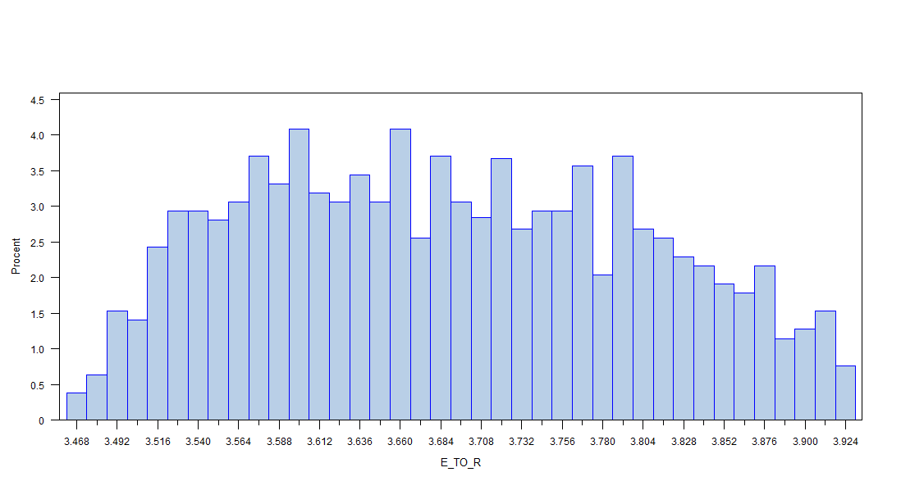
Finite element method (2D)
Parameters of geosphere triangular mesh:
Max(ER) ≈ 3,9245 (113.29% x ER_min.)
ER_ideal ≈ 3,4641

Slide 21
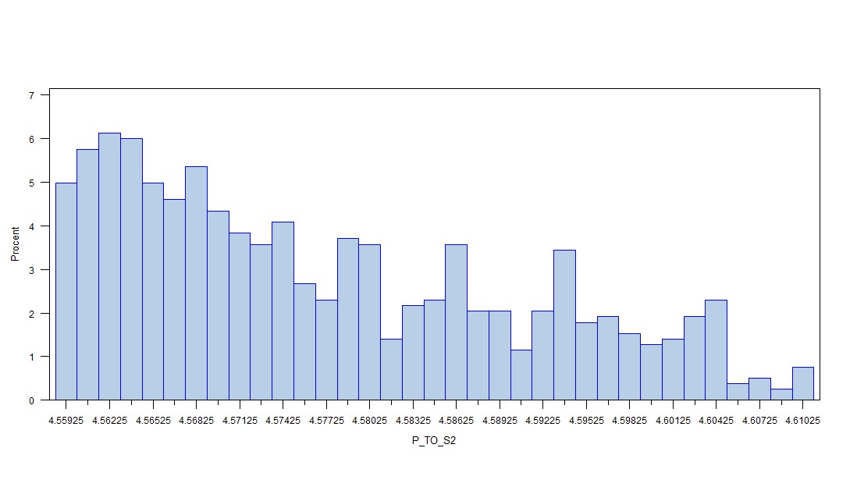
Finite element method (2D)
Parameters of geosphere triangular mesh:
Max(PS) ≈ 4,6104 (101.13% x PS_min.)
PS_ideal ≈ 4,5590

Slide 22
Finite element method (2D)
Which method should be used to verify the quality of the two-dimensional mesh?

Slide 23
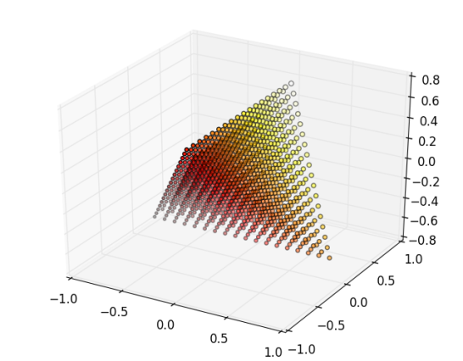
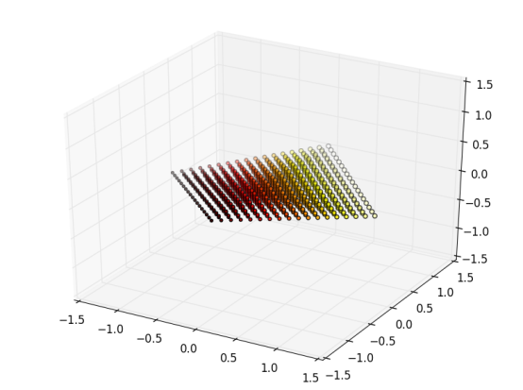
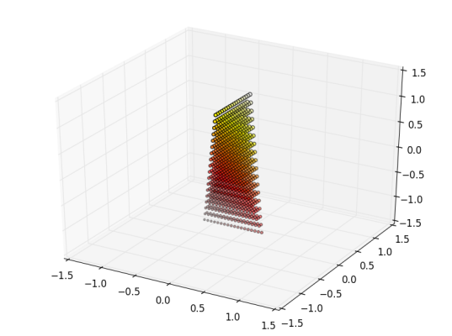
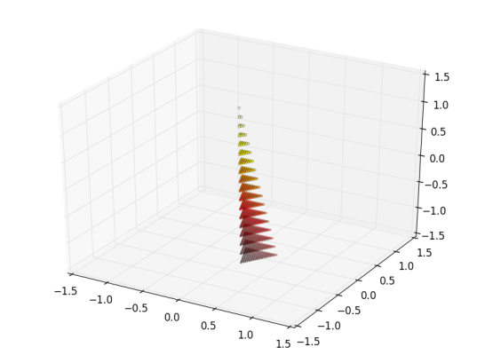
Finite element method (3D)
Three-dimensional mesh – cubes, tetrahedra, …
Tetrahedral mesh allows for dense packing of points
Disadvantage – three-dimensional space cannot be filled with regular tetrahedra (as it was for triangles in 2D)
Parameters of a tetrahedron
Heights, surface area, volume
Inscribed sphere, dihedral angles, face angles, solid angles
Quality measures – different kinds of tetrahedra

Slide 24
Finite element method (3D)
Quality measures of a tetrahedron:
a) (S^{1/2})/(V ^{1/3}) simple, zero-dimensional and independent of the tetrahedron size; (S2_TO_V3, SV)
b) longest edge of tetrahedron / radius of the inscribed sphere (E_TO_R, E/R, ER); also size-independent and zero-dimensional;
c) „aspect ratio” – longest edge / shortest tetrahedron height (E_TO_H, EH), used in TetGen(R) (Si 2008a, 2008b; Si 2013)
The ideal values for the regular tetrahedron should be:
S2_TO_V3 = (3^{1/4}) x(72^{1/6}) ≈ 1.316074 x 2.039649 ≈ 2.684329;
E_TO_R = 2*(6^{1/2}) ≈ 4.8989;
E_TO_H = (3^{1/2})/(2^{1/2}) ≈ 1.2247

Slide 25
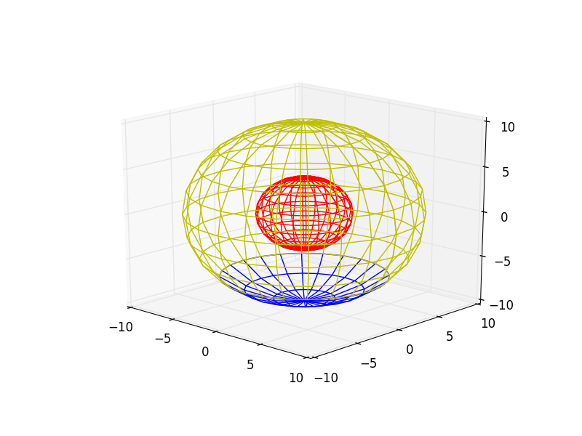
Simplified 3D model of a presynaptic bouton
Design of the surface mesh of the 3D model (Python)
„Globe” – bouton model (Ω) (yellow)
Radius – 10 units
24 „meridians” (i.e. with 15° interval)
11 „circles of latitude” (also with 15° interval)
Synthesis zone of NT (Ω₃) (red)
Radius – 4 units
Subdivision as for (1.)
Docking site (active zone, release zone) of NT (∂Ω_{d}) (blue)
It is a part of (1.)
Shape – spherical cap
„Latitude”: from 90°S to 45°S

Slide 26
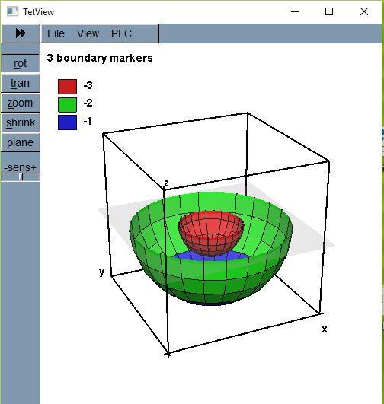
Simplified 3D model of a presynaptic bouton (surface)
Generation of the bouton 2D surface (Python): results
Bouton: membrane (including docking site) : R = 10
266 nodes (1x„North Pole”+1x„South Pole”+11x24)
288 segments (240 „rectangles”, 2 x 24 „triangles”)
Synthesis zone (Ω₃) boundary
266 nodes, 288 segments
r = ¼ x [radius(1.)]
Docking site (∂Ω_{d})
First part of (1.)
1+3 x 24 = 73 nodes
3 x 24 = 72 segments
{membrane}\{docking site}
8 x 24+1 = 193 nodes
9 x 24 = 216 segments
Bouton section (lower half)

Slide 27
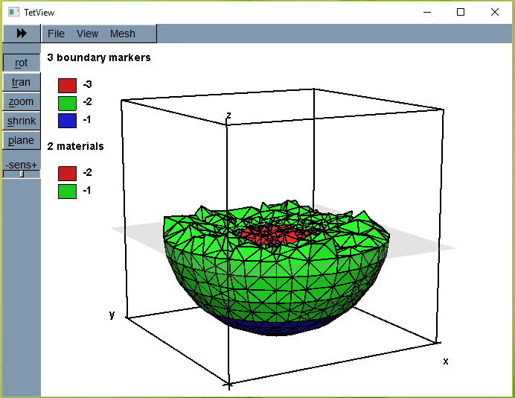
Simplified 3D model – after tetrahedralization
Mesh generated with TetGen® ( TetView® picture)
Synthesis
Docking
Other
Rescaled
bouton:
(unit=0,16μm)
R = 0,16μmx10
= 1,6 μm
r = 0,16μmx4
= 0,64 μm

Slide 28
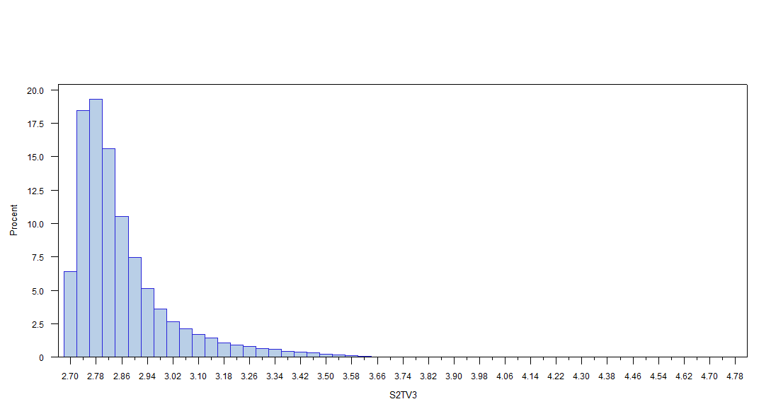
Mesh quality measure (1 - experimental) S^{1/2} / V^{1/3} (ideal≈2,684)

Slide 29
Measure „1” (continued)
Variable: S2TV3
Extreme values
----Lowest--- ----Highest---
Value Obs. Value Obs.
2.68487 19141 3.86529 16804
2.68506 36608 3.89762 3627
2.68507 35950 4.20637 662
2.68521 17342 4.38934 7415
2.68524 8813 4.78667 2882

Slide 30
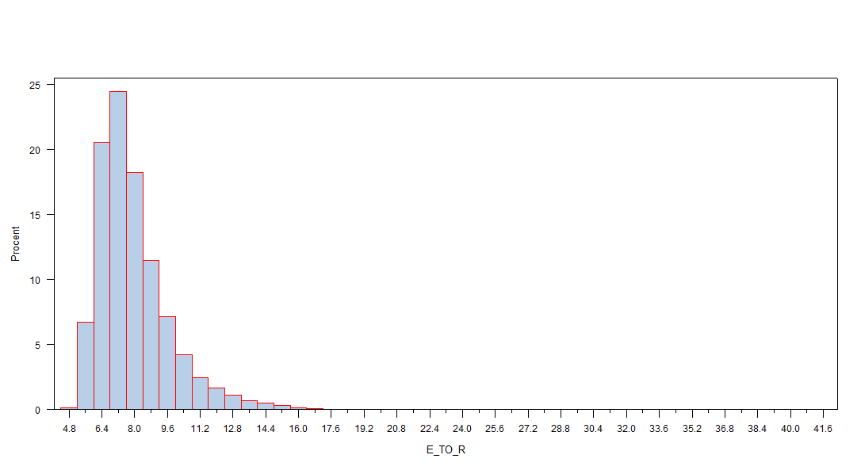
Mesh quality measure (2 – from the book*) E / R (ideal≈4,899)
E/R = longest edge / radius of inscribed sphere
* P.G.Ciarlet, 1978. The finite element method

Slide 31
Mesh quality measure (2) (continued)
Variable: E_TO_R
Extreme values
----Lowest--- ----Highest---
Value Obs. Value Obs.
4.98830 19141 21.2470 3627
4.99580 8813 22.6285 1200
5.00145 17342 28.3678 662
5.00343 22840 28.6172 7415
5.01019 14400 41.7902 2882

Slide 32
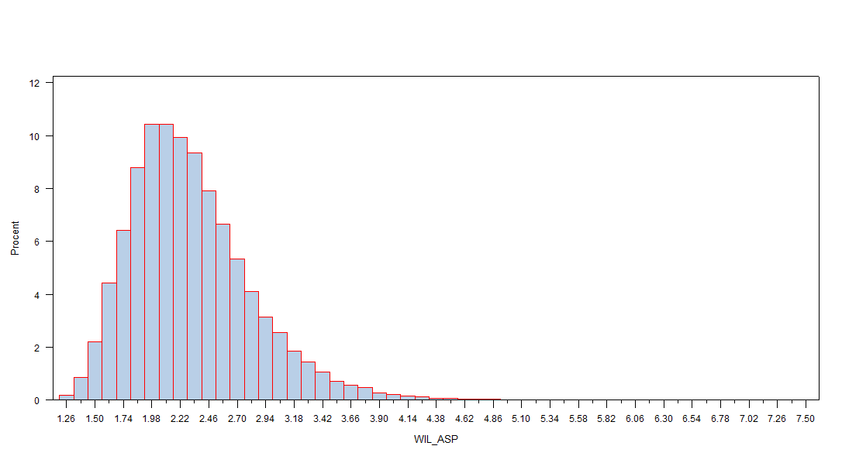
Mesh quality measure (3 – in TetGen® programme) SI_ASP (ideal≈1,155)

Slide 33
Mesh quality measure(3) (continued)
Variable: SI_ASP
Extreme values
----Lowest--- ----Highest---
Value Obs. Value Obs.
1.20322 19141 5.76625 20737
1.21465 36608 5.85661 8851
1.21612 22840 6.07814 21246
1.22030 17342 6.63224 2978
1.22383 35950 7.52163 32193

Slide 34
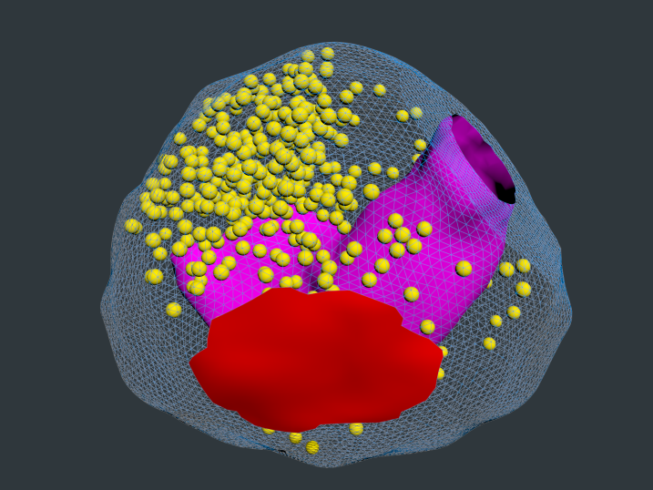
3D realistic model (first approach)

Slide 35
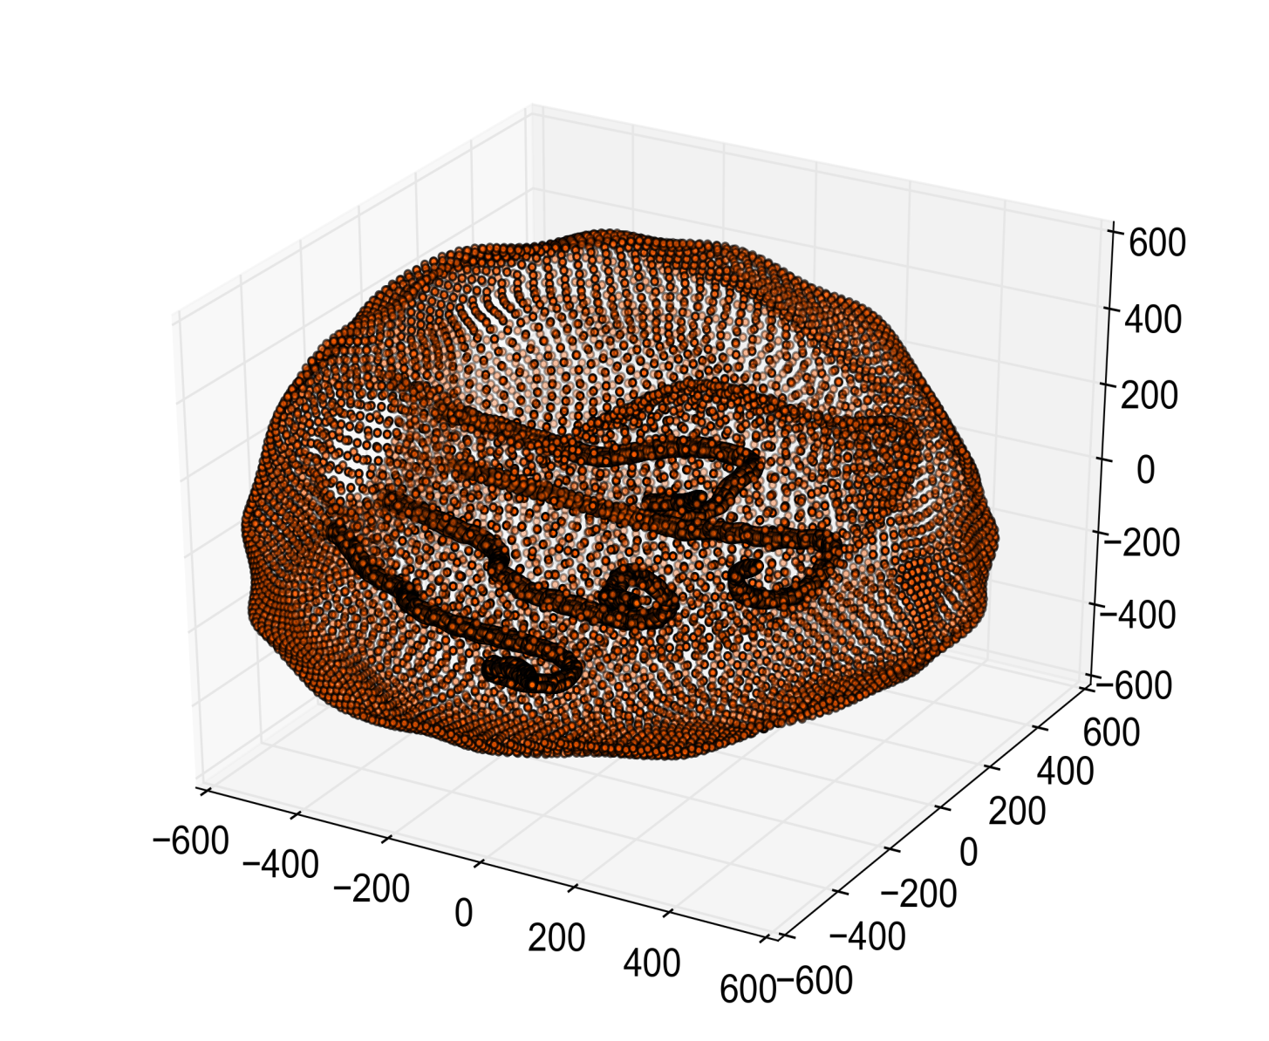
3d realistic model (second approach) with mitochondrion and microtubules
z

Slide 36
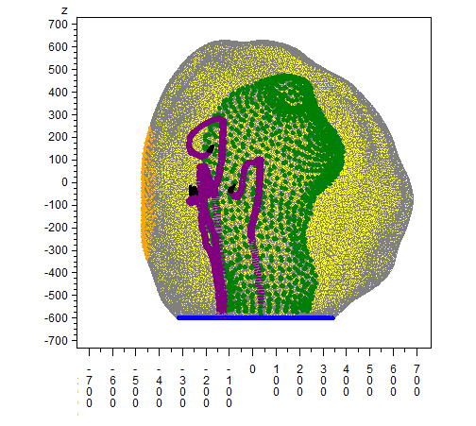
3d realistic model (second approach, another view) with mitochondrion and microtubules
y

Slide 37
Mesh assumptions (4) : for simulations in 2D and 3D
Mesh: triangles (2D) or tetrahedra (3D)
Each triangle / tetrahedron has quality measure:
Triangle: longest edge / radius of inscribed circle (P/R)
Tetrahedron: longest edge / radius of inscribed sphere (E/R);
REMARK: analogous measure may be applied in more (4, 5 etc.) dimensions
The measure defined above is dimensionless.
P.G.Ciarlet, 1978. The finite element method

Slide 38
SIMULATION IN 2D
(assumptions, mesh, results)

Slide 39
Assumptions: main simulation parameters (2D)
Bouton surface area m(Ω) ≈ 8.06μm²
Measure of NT release domain m(∂Ω_{d} ) ≈ 3.46μm
Measure of NT ssynthesis (supply) domain m(Ω₃) ≈ 3.02 μm²
Diffusion coefficient a₁₁, a₂₂ = 10⁻² · 300 μm²/s
Excitatory impulse duration time τ = 4 · 10⁻⁴ s
Initial density of NT ρ₀ = 10423 1/μm²
Synthesis (supply) threshold ρ = 23198 1/μm²
Synthesis rate α = 20.8 μm/s

Slide 40
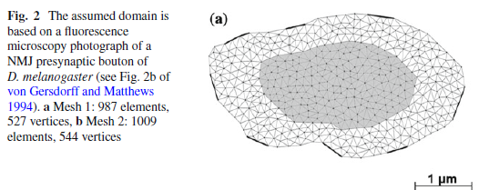
2D model assumptions: bouton parameters
Bielecki A. et al. Biol Cybern (2010) 102:489–502

Slide 41
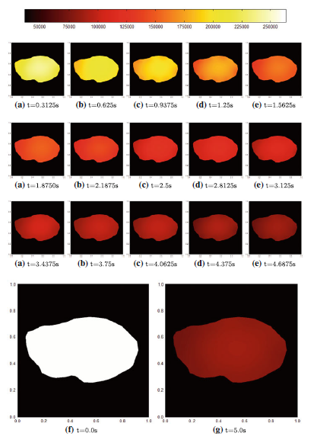
Simulation results (2D): ρ(x,t) t: 0-5s

Slide 42
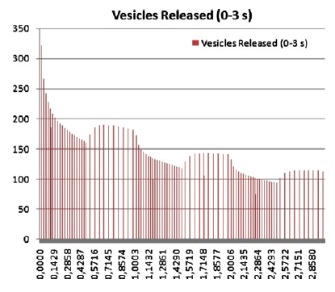
2D simulation results – time range t: 0-3s
Assumption:

Slide 43
Simplified 3D model

Slide 44
Simplified 3D bouton model (surface)
Mesh generation (3D) in the bouton (TetGen® -wersjaC++)
Input parameters for TetGen® (first example)
$ ./tetgen -pq4.0/19VAa4.0 param29.poly
Parameters:
dihedral angles ≥ 14º)
4.0/19 max. quality measure*/
optimized mesh dihedral angles[°]
V print
A assign attributes to the regions
a4.0 max. tetrahedron volume
max. edge / min. tetrahedron height
(Ciarlet: The finite element methods, 1978)

Slide 45
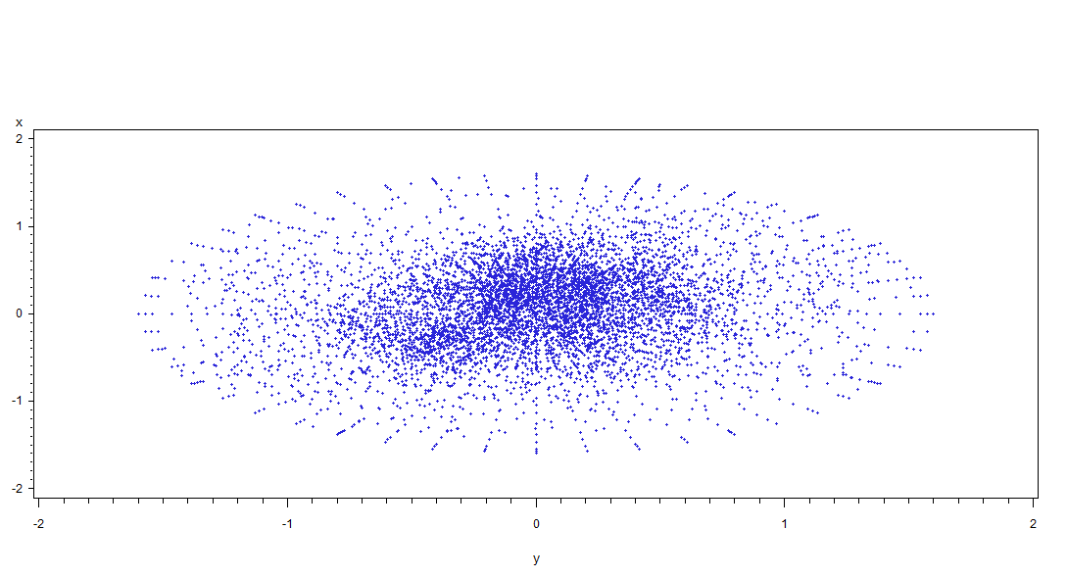
Mesh vertices distribution (plot surface: 4x4μm)

Slide 46
Mesh quality measure(1 - experimental) S^{1/2} / V^{1/3} (ideal ≈ 2,684)

Slide 47
Mesh „1” (continued)
Variable: S2TV3
Extreme observations
----Lowest---- ----Highest----
Value Obs. Value Obs.
2.68487 19141 3.86529 16804
2.68506 36608 3.89762 3627
2.68507 35950 4.20637 662
2.68521 17342 4.38934 7415
2.68524 8813 4.78667 2882

Slide 48
Mesh quality measure (2 – theoretical*) E / R (ideal ≈ 4,899)
E/R = the ratio of he longest edge
to the radius of the inscribed circle
* P.G.Ciarlet, 1978. The finite element method

Slide 49
Mesh quality measure (2) continued
Variable: E_TO_R
Extreme observations
----Lowest---- ----Highest----
Value Obs. Value Obs.
4.98830 19141 21.2470 3627
4.99580 8813 22.6285 1200
5.00145 17342 28.3678 662
5.00343 22840 28.6172 7415
5.01019 14400 41.7902 2882

Slide 50
Mesh quality measures (3 – in TetGen®) SI_ASP (ideal ≈ 1,155)

Slide 51
Mesh quality easures (3) (continued)
Variable: SI_ASP
Extreme observations
----Lowest---- ----Highest----
Wartość Obs. Wartość Obs.
1.20322 19141 5.76625 20737
1.21465 36608 5.85661 8851
1.21612 22840 6.07814 21246
1.22030 17342 6.63224 2978
1.22383 35950 7.52163 32193

Slide 52
Parameters for FEM
Formula of the simulation model
Parameter values:
ρ(x,0) = 7200μm⁻³ e^{(-0,28/μm2)r2} (r²=x²+y²+z²)
a_{ij} : diffusion tensor (diagonal) [300μm²/s]/[10^{k}] (k=2)
f(x) : spatial distribution of synthesis rate
f(x) = β₀ for ρ(x,t) < ρ
ρ = 6000 (1 / μm³ )
Release of NT ➔
( α = 20,8 μm³/s )
β₀ = 3,12(1/s)

Slide 53
DATA STRUCTURES

Slide 54
Data structure (I) (file of mesh elements)
File contents: list of records (tetrahedra)
number of tetrahedra – n_tet
Record contents:
Record (tetrahedron) number – i_tet
Numbers of vertices:
vn[0] … vn[3] = nn[i_tet][0] … nn[i_tet][3]
Coordinates of vertices:
x_{vn[0]},y_{vn[0]},z_{vn[0]}, …, x_{vn[3]},y_{vn[3]},z_{vn[3]}
Tetrahedron volume: – V[i_tet]
Attributes (flags) of vertices:
av_{vn[0]}, av_{vn[1]}, av_{vn[2]}, av_{vn[3]}
Attributes(flags) of tetrahedra – at[i_tet]

Slide 55
Data structure (II) (file of mesh elements)
List of lists: nt_vol (no. of list elements = no. of tetrahedra)
List element (i-th tetrahedron) – list:
numbers of nodes:
nt_vol[i][0] … nt_vol[i][3]

Slide 56
Algorithm and its complexity
Iteration of time
Loop over tetrahedra
Loop over nodes

Slide 57
3D simulation – 5s (Three-dimensional simulation of presynaptic release and depression, w recenzji)
Simulation parameters:
Volume of the bouton: 16,673μm³
Volume of the synthesis region NT: 1,067 μm³
Surface of the bouton: 32,159μm²
Surface of the release area NT: 4,628 μm²
Speed of neurotransmitter release: 41,6 μm³/s
Diffiusion tensor (diagonal) [300μm²/s]/[10^{k}] (k=2)
Speed of neurotransmitter synthesis: 0,0115 1/s
Starting spatial distribution:
ρ(x,0) = 7200μm⁻³ e^{(-0,28/μm2)r2} e^{0,1U(-1,1)} (r²=x²+y²+z²)
U(-1,1) – random variable which has uniform distribution on the interval [-1,1]

Slide 58
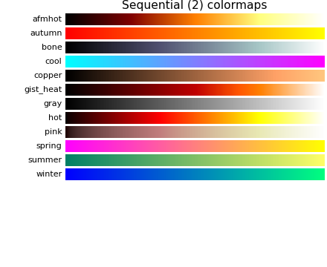
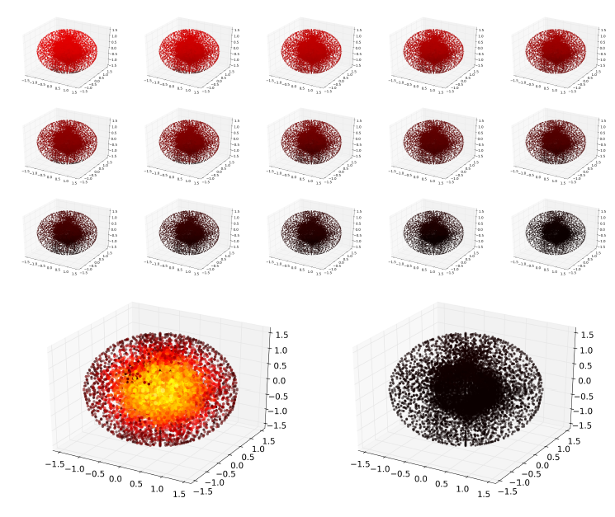
Simulation 3D – spatial distribution of vesicles (x,y,z)
ρ(x,t)[μm⁻³]=3000 4000 5000 6000 7000 8000

Slide 59
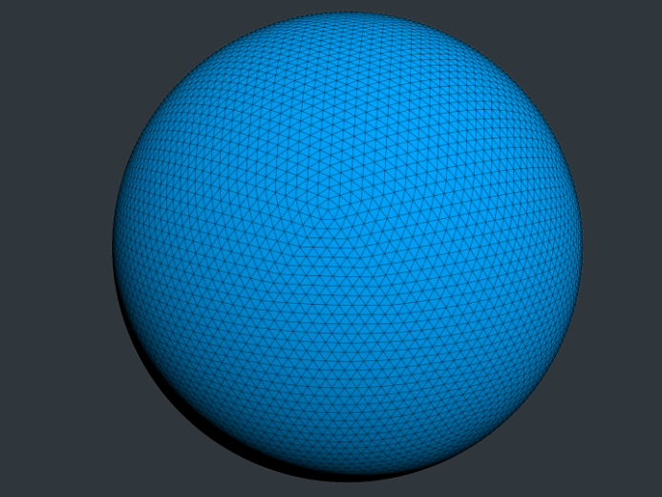
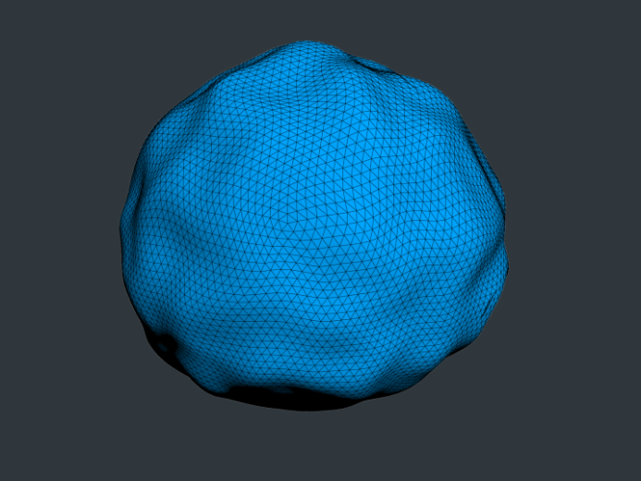
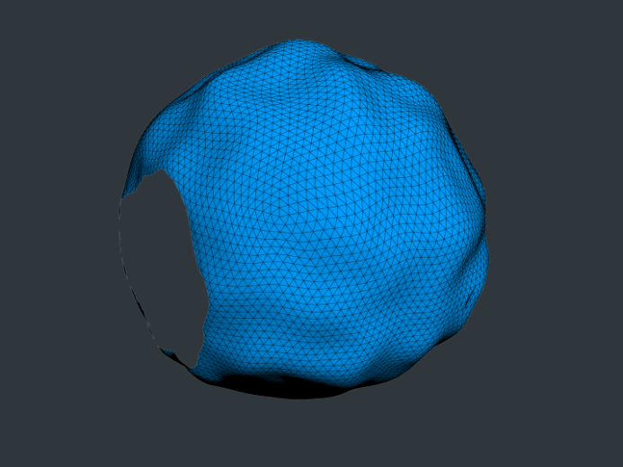
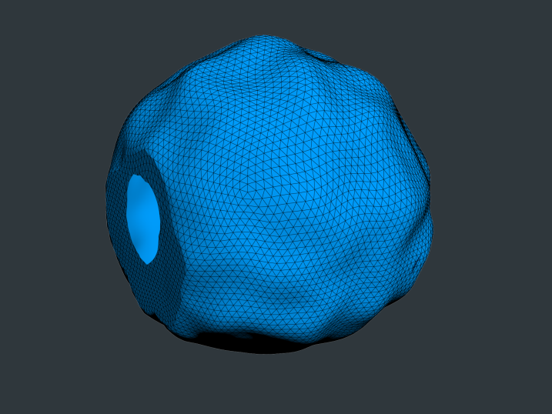
Realistic geometric model 3D

Slide 60
Geometric parameters:
Parameter Value
Volume 1.1 ± 0.1 μm³
Surface 4.4 ± 0.3 μm²
Number of Vesicles 383.7 ± 37.9
Volume occupied by vesicles 0.015 ± 0.001 μm³
Number of Active Zones per synapse 0.71 ± 0.09
Average size of Active Zone 0.21 ± 0.04 μm²
Number of mitochondria per synapse 0.65 ± 0.08
Average size of mitochondria 0.18 ± 0.04 μm³
Wilhelm, B.G.: Stoichiometric Biology of the Synapse. Dissertation in partial ful-
llment of the requirements for the degree „Doctor of Natural Sciences” (Dr. rer.
nat) in the Neuroscience Program at the Georg August University Göttingen,
Faculty of Biology, Göttingen,, Germany (2013)

Slide 61
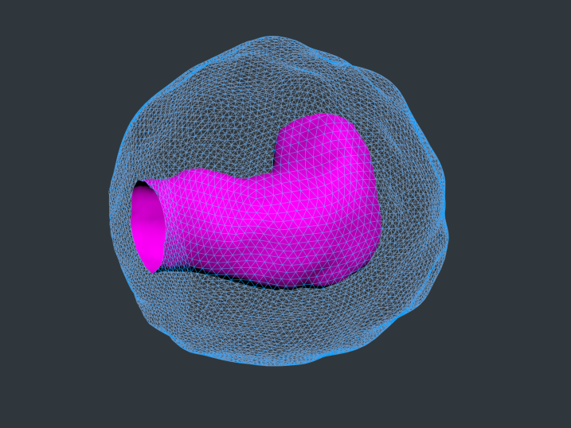
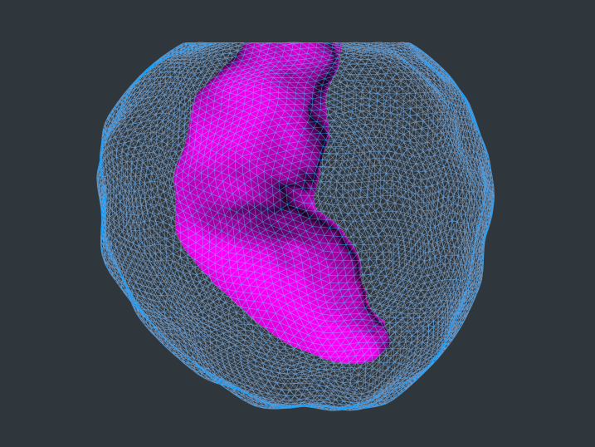
„First, a simple box object with only a small number of triangles was con-
structed. It was then modied by hand and a MeshSmooth modier, which
increases number of triangles and creates smooth mesh using NURMS (non-
uniform rational mesh smooth) subdivision algorithm, was applied. This tech-
nique, known as box modeling,”

Slide 62
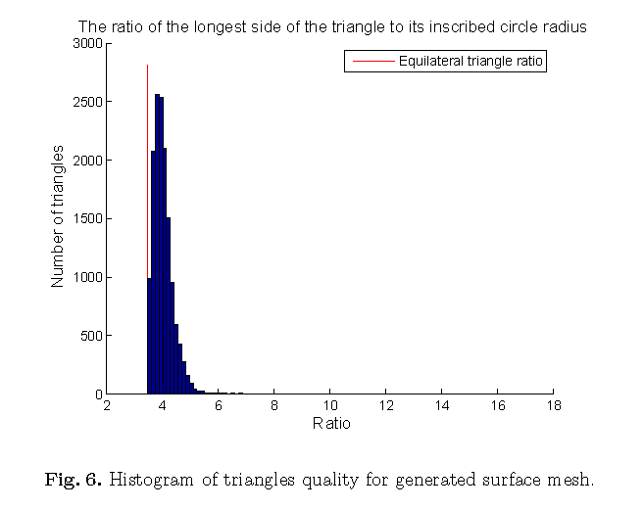
Generated mesh quality

Slide 63
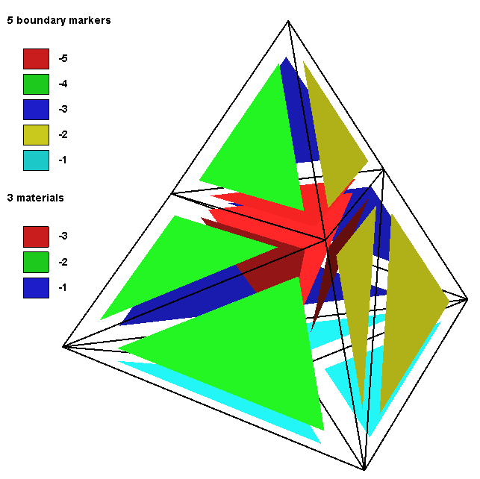
Another model – mitochondrion and microtubules inside the bouton
mesh division – one element

Slide 64
Another model – mitochondrion and microtubules inside the bouton

Slide 65
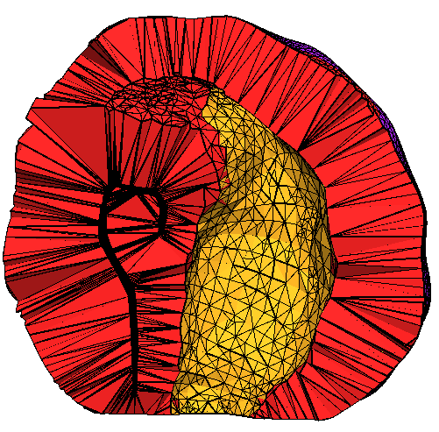
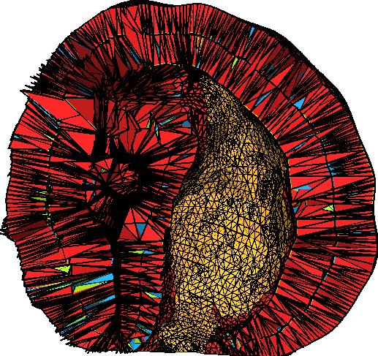
Another model – mitochondrion and microtubules inside the bouton
mesh division – whole mesh

Slide 66
Alternative models
Choice of time step
Choice of cellular automaton
Choice of membrane computing

